Slide 1


Introduction to Machine Learning and Data Analytics
Tri-duc Nghiem
Duc.Nghiem@pipepredict.com

Slide 2
Overview
Machine Learning
Supervised learning
Unsupervised learning
Semi-supervised learning
Reinforcement learning
Data analytics
What to do?
Big data?
Practice
Playing around with scikit-learn, matplotlib

Slide 3
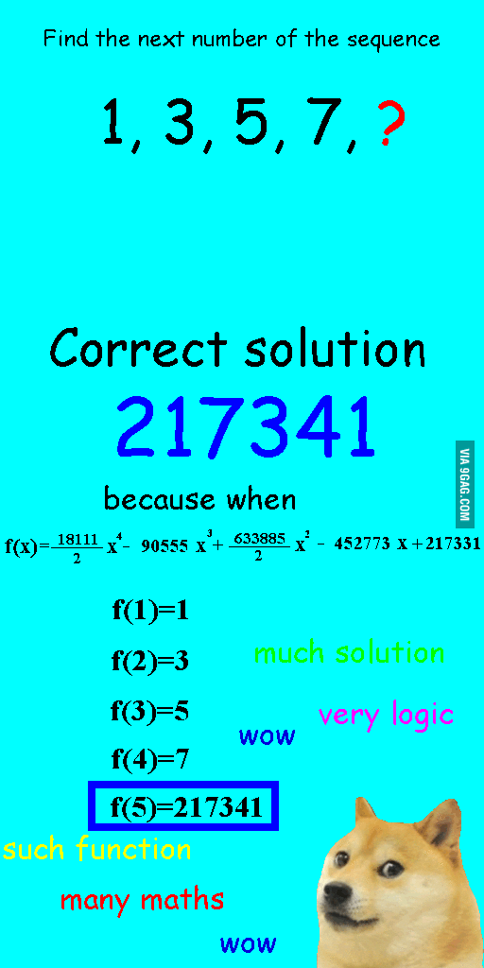
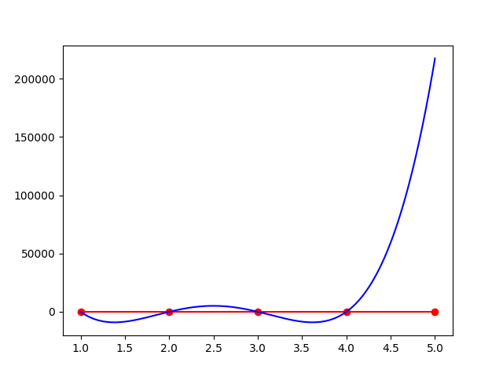
Part I: Machine Learning
Example:
Given a series of integer numbers:
1, 3, 5, 7, …
What is the next number?
A linear model (series of odd numbers) will give us 9, but a polynomial function (degree of 4 as below) will give us: 217341

Slide 4

Part I: Machine Learning
And more:
R = $\frac{U}{I}$
$F=G\frac{\left(m_{1}×m_{2}\right)}{r^{2}}$
(It’s true until Einstein proved it’s wrong)
“All models are wrong, but some are useful”
George Box

Slide 5


I.I Supervised Machine Learning
Observation:
${(x}_{i}, y_{i})$ where $i=1..n$
Estimate F(x) = y with set of parameters and hyper-parameters
Such that the loss over the observation set is minimum:
Minimize $loss=\sum_{i}{L(F\left(x_{i}\right),y_{i})}$
Example:
In the first example: $y=w_{0}+w_{1}×x+w_{2}×x^{2}+w_{3}×x^{3}+w_{4}×x^{4}$
Hyper-parameters: degree of the polynomial: 4
Parameters: $w(w_{0},w_{1},w_{2},w_{3},w_{4})$
Deep Learning is nothing different, it’s just a chain of functions applied on the inputs

Slide 6
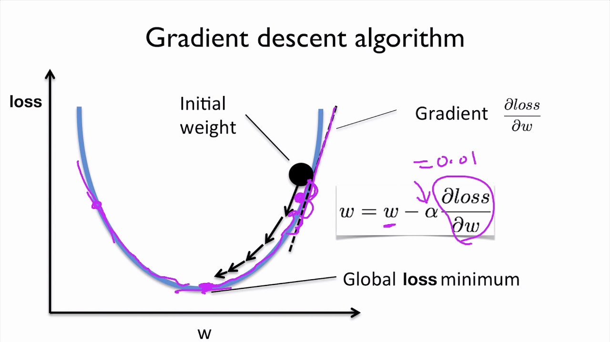



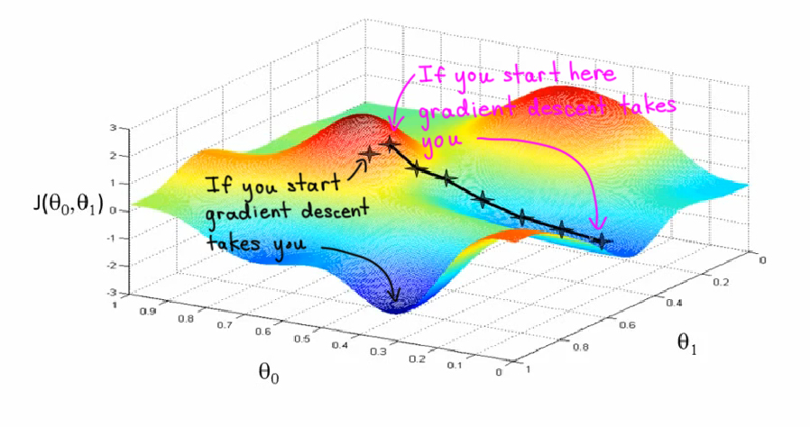

I.I Supervised Machine Learning How does it work?
This Photo by Unknown Author is licensed under CC BY-SA
This Photo by Unknown Author is licensed under CC BY-SA

Slide 7
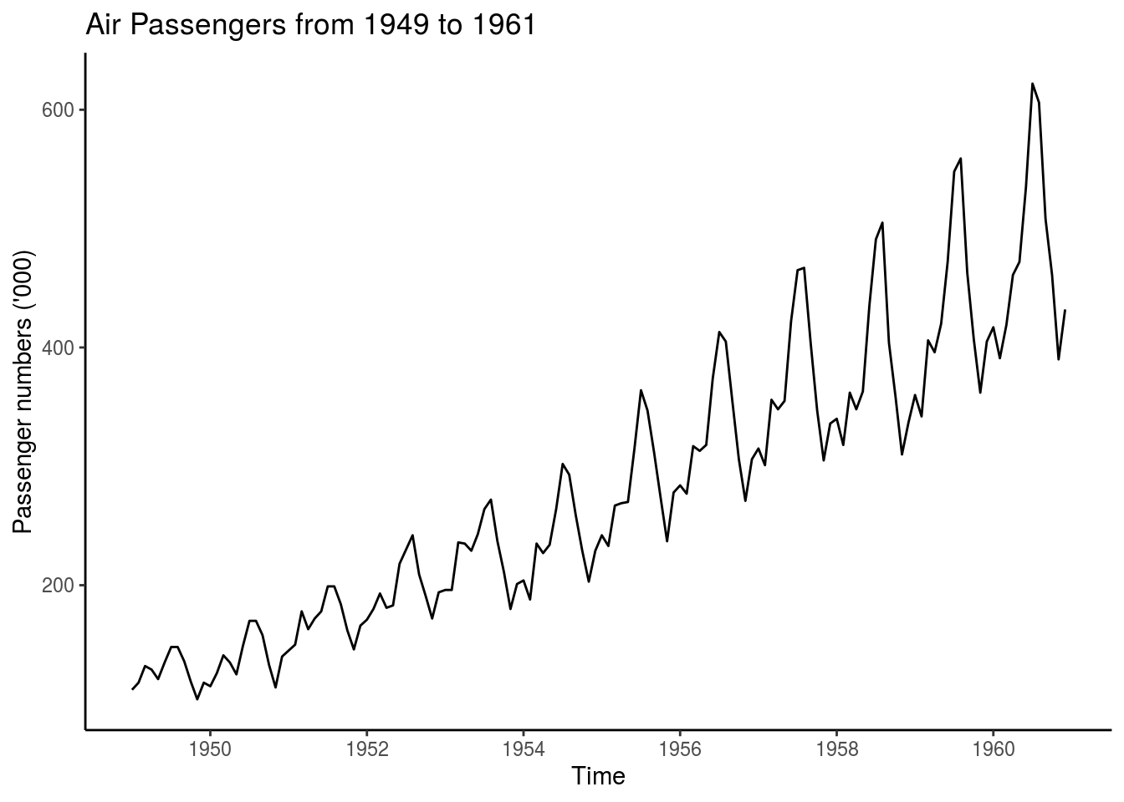
I.I Supervised ML: Regression
If F estimates continuous output, then the problem is a regression problem
Regular Regression problems:
Predict the price of a house / an apartment based on:
Location
Size
built-year
Timeseries: forecast future values of a series based on observed set of values
Price of flight ticket
Stock market

Slide 8
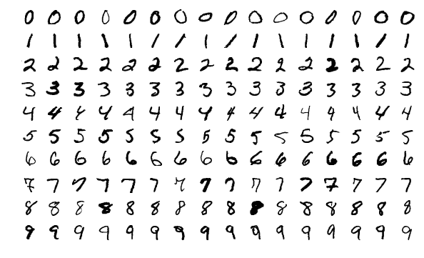
I.I Supervised ML: Classification
If F’s range is discrete and limited
Examples:
Spam filter (binary classification)
Text categorization (multiple-class classification)
Handwriting recognition
Speech recognition
…
Example of MNIST Dataset – handwriting digits recognition

Slide 9
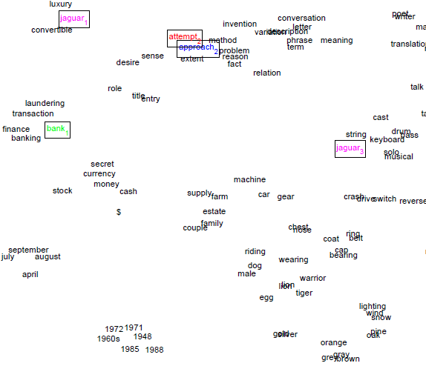
I.I Supervised ML: Representation
When F(X) -> X’, it’s representation problem
X’ may have less dimension or larger
Sometimes it’s referred as autoencoder, feature learning
Technically, it’s unsupervised as we don’t need labels; but mechanically it works as supervised algorithm since you still need a lot of (unlabeled) data to fit the function
Example:
Word embedding: words are represented as vectors
Word vectors visualization showed that it can capture semantic level of words

Slide 10
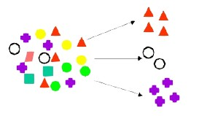
I.II Unsupervised Machine Learning
No labels are given to the learning algorithm, leaving it on its own to find structure in its input
Examples:
Group objects according to their shape
This Photo by Unknown Author is licensed under CC BY-SA-NC

Slide 11
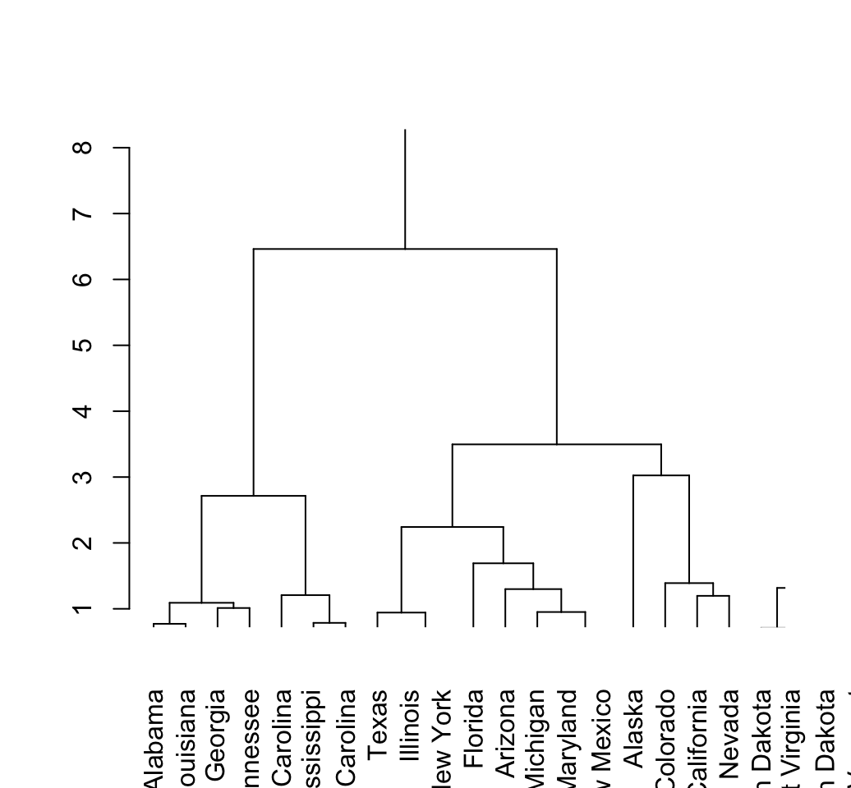
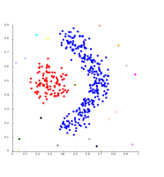
I.II Unsupervised ML Clustering
Discovering clusters
Clustering data into groups
Hierarchical clustering
Partitional clustering
Hierarchical clustering
Partitional Clustering

Slide 12
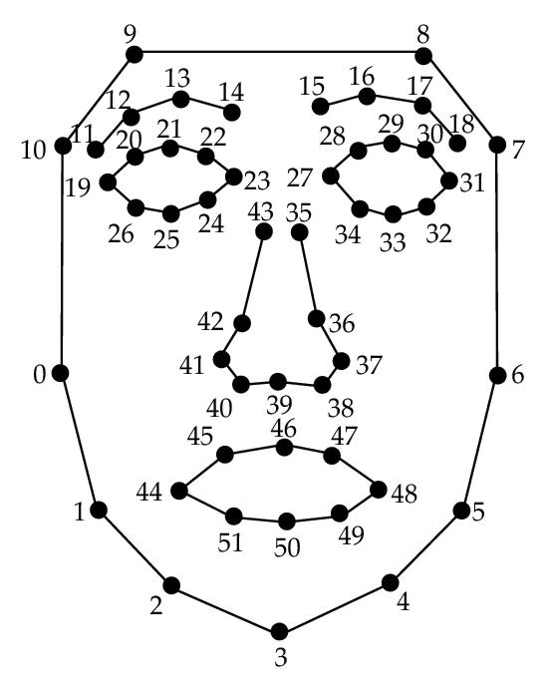
I.II Unsupervised ML Discovering Latent Factors
Discovering latent factors
Dimensionality reduction: reduce high dimensional data to a lower dimensional subspace.
E.g: there are many features representing an images, but just few are important: lighting, pose, identity…
This Photo by Unknown Author is licensed under CC BY

Slide 13
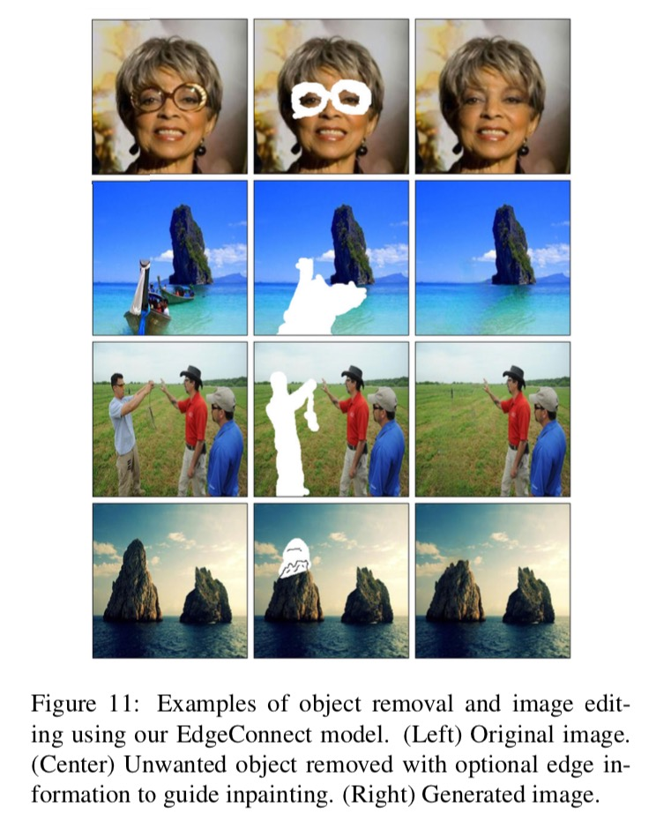
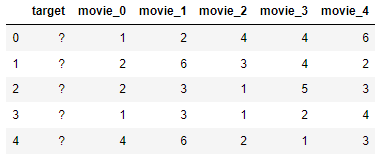
I.II Unsupervised ML Matrix Completion
If we have missing data, then the goal of this task is filling the gaps with numbers based on the surrounding values
Tasks:
Image inpainting
Collaborative filtering
E.g: Given rating matrix of users with watched movies, predict how likely they would rate an unwatched one.
This Photo by Unknown Author is licensed under CC BY-SA
This Photo by Unknown Author is licensed under CC BY-NC

Slide 14
I.III Semi-supervised Learning
If you have a small set of labelled data, and one to use them as a seed to grow the data bigger:
Train your supervised model on that small dataset
Run prediction on the bigger data set and get labels
Revise the quality
Use that data as training data…

Slide 15
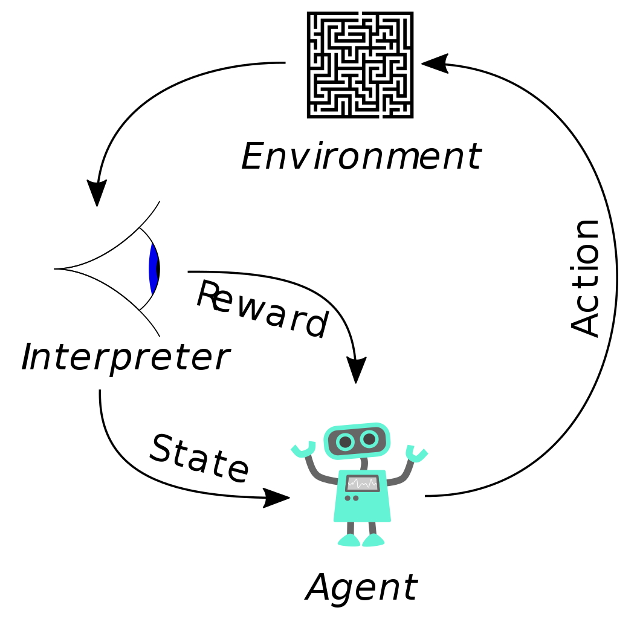
I.IV Reinforcement Learning
Reinforcement learning (RL) is an area of machine learning concerned with how software agents ought to take actions in an environment in order to maximize the notion of cumulative reward.
Source: wikipedia - https://en.wikipedia.org/wiki/Reinforcement_learning

Slide 16
Part II: Data Analytics – What to do?
Here are questions you have to answer:
What problem you are going to solve?
Is the data in good quality and in the format that you can load into memory and work with?
Is it big enough?
What model am I going to use?
How do I improve the performance of the model I am using?
How do I evaluate the result?
Visualize results?

Slide 17
II.I Data Analytics – What to do? Preprocessing
Filtering, cleaning up data
Data conversion
Feature extraction
Feature engineering:
Extract more features from given data
Transform the features (feature scaling)

Slide 18
II.I Data Analytics – What to do? Model Selection
Split data into training set, test set, validation set (optional) if your problem is supervised
Choose some models with different hyper-parameters and train them on the training set.
To tune the hyper-parameters, run it on validation set or n-fold validation on training set
Never do this:
Train and test on the same data set -> over fitting your model
Train on training set and test on test set but repeatedly until archive the best set of hyper-parameters -> overfitting

Slide 19

II.I Data Analytics – What to do? Evaluation
Regression:
mean square error, root mean square error
$mse=\frac{\left(\sum_{i}{{\left(y_{i}−y_{i}^{∗}\right)}^{2}}\right)}{n}$
Mean absolute error
$mae=\sum_{i}{\frac{\left|y_{i}−y_{i}^{∗}\right|}{n}}$
R square:
$R^{2}=1 −\frac{\sum_{i}{{\left(y_{i}−y_{i}^{∗}\right)}^{2}}}{\sum_{i}{{\left(y_{i} − ̅y\right)}^{2}}}$

Slide 20

II.I Data Analytics – What to do? Evaluation
Classification: Precision, Recall, F-1
True Positive: accurately classified as positive label (TP)
E.g: AIDS positive true, corona positive true
True negative: accurately classified as negative label (TN)
E.g: AIDS negative true, corona negative true
False Positive: wrongly classified as positive label (FP)
E.g: don’t have AIDS, corona but got positive test
False Negative: wrongly classified as negative label (FN)
E.g: have AIDS, corona but got negative result
$Precision=\frac{TP}{TP+FP},$
$Recall=\frac{TP}{TP+FN},$
$F1=\frac{2\left(P×R\right)}{P+R},$
$accuracy=\frac{TP+TN}{TP+TN+FP+FN}$

Slide 21
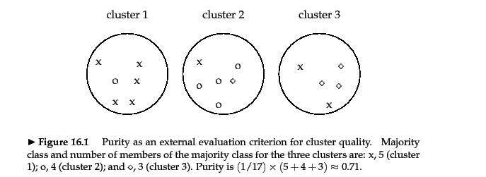
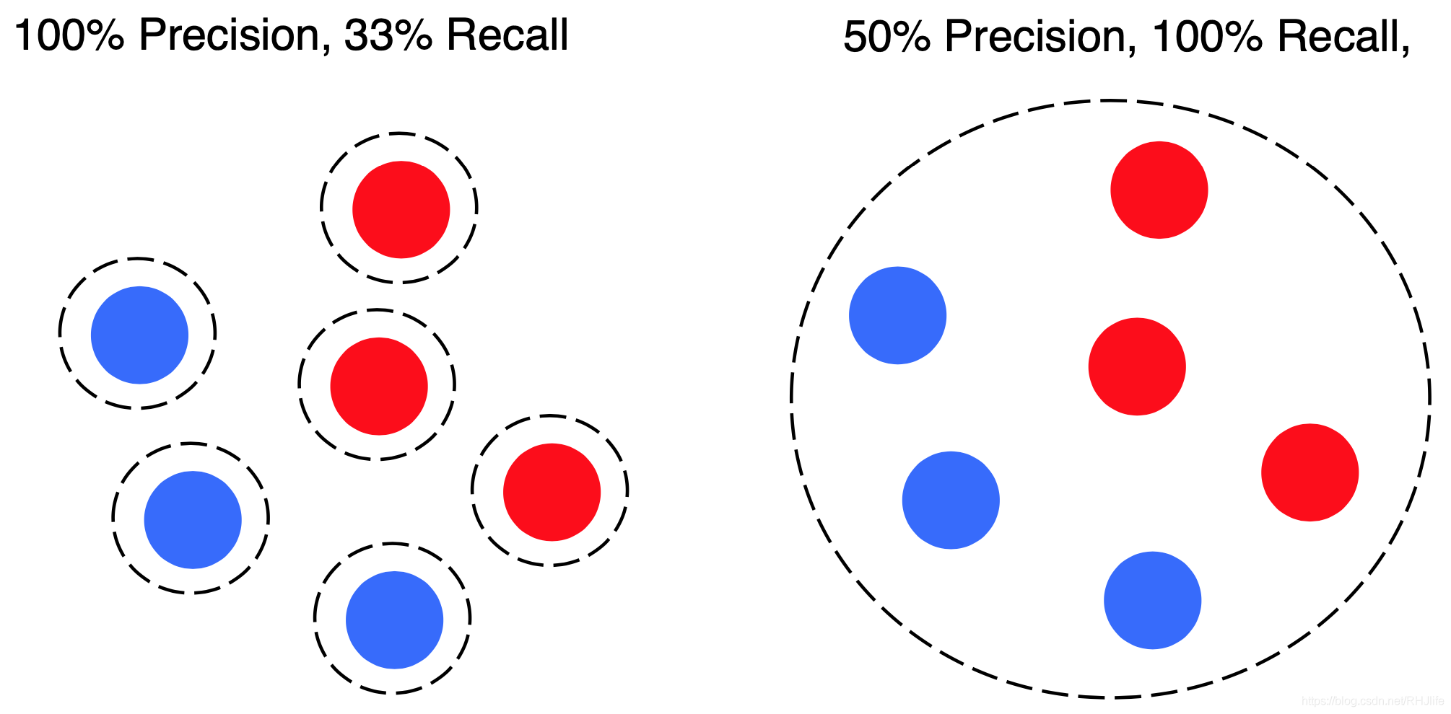
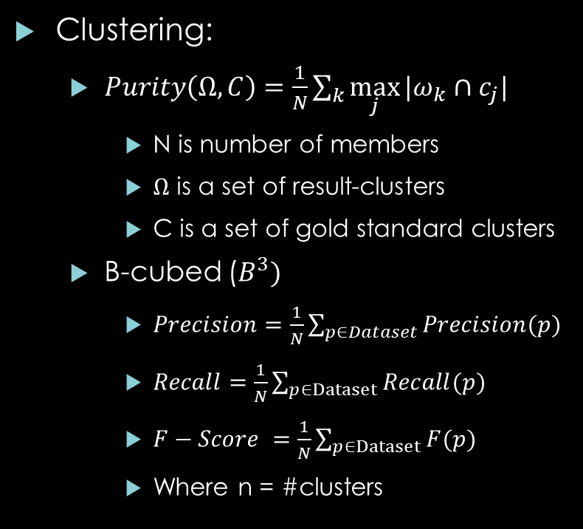
II.I Data Analytics – What to do? Evaluation
Clustering:
$Purity\left(Ω, C\right)=\frac{1}{N}\sum_{k}{\max_{j}{|ω_{k}∩c_{j}|}}$
N is number of members
$Ω$ is a set of result-clusters
C is a set of gold standard clusters
B-cubed ($B^{3})$
$Precision=\frac{1}{N}\sum_{p∈Dataset}{Precision(p)}$
$Recall=\frac{1}{N}\sum_{p∈Dataset}{Recall(p)}$
$F−Score =\frac{1}{N}\sum_{p∈Dataset}{F(p)}$
Where n = #clusters

Slide 22
II.I Data Analytics – What to do? Visualization
Features visualization
Sub-space selection – our intuition is limited to 3-d space
Result visualization
Selection of positive results
Selection of negative results (no system is perfect, even human)
Be creative! People love to see charts than table of numbers

Slide 23
Part II: Big Data
If you have a big data (how big should be considered as big, well say 5TB data with the RAM and Hard Drive capacity at the moment – 2020), then you have to concern the technical issue to work with it as you cannot load them all to memory to analyze
Solution: “divide and conquer”, take advantage of parallel computing
There are many techniques out there, but the most famous in the recent years is: Hadoop (Map – Reduce)

Slide 24
Materials and Classes
Books:
Machine Learning – Tom Mitchell
Machine Learning A probabilistic Perspective – Kevin P. Murphy (Advanced)
Timeseries analysis – Hamilton
Applied Multivariate Statistical Analysis – Richard A. Johnson and Dean W. Wichern
Online course:
Machine Learning – Andrew Ng (Recommended)
https://www.coursera.org/learn/machine-learning
DeepLearning.ai – Andrew Ng (Recommended)
https://www.coursera.org/specializations/deep-learning
Tip:
Select audit mode to attend those courses without certificate (and so they’re free)

Slide 25
Part III Practice
Playing with Regression
Playing with classification

Slide 26
Part III Practice General TIPS
Import libraries
from library import classes, functions, defintions…
Import library
Numpy is library for matrix computation
Pandas is for loading structured data into DataFrame (similar concept as excel sheet with rows and columns), Series
Matplotlib is data visualization library
Sklearn is library for basic machine learning algorithms

Slide 27
Part III Practice General TIPS
Dataset:
https://scikit-learn.org/stable/datasets/index.html
Loading dataset:
Regression:
from sklearn.datasets import load_boston
X, y = load_boston(return_X_y=True)
Classification:
sklearn.datasets.load_breast_cancer

Slide 28
Part III Practice General TIPS
Feature Engineering:
Scaling and transformation:
from sklearn import preprocessing
More here:
https://scikit-learn.org/stable/modules/preprocessing.html

Slide 29
Part III Practice General TIPS
Linear Regression:
https://scikit-learn.org/stable/modules/generated/sklearn.linear_model.LinearRegression.html
Logistic Regression (it’s actually a classifier)
https://scikit-learn.org/stable/modules/generated/sklearn.linear_model.LogisticRegression.html
Support Vector Machine
Regressor: https://scikit-learn.org/stable/modules/generated/sklearn.svm.SVR.html
Classifier: https://scikit-learn.org/stable/modules/generated/sklearn.svm.SVC.html

Slide 30
Part III Practice General TIPS
Train and predict
Choose your model: model = YourModel(hyper_parameters)
Fitting model with training set: model.fit(x,y)
Predict:
y_hat = model.predict(x_test)
Remember to scale the x_test before predict, if you scaled your training features
Evaluation:
https://scikit-learn.org/stable/modules/model_evaluation.html

